Slide 1
Keras
Deep learning library for Python

Slide 2
What is Deep Learning:
Deep learning is a subset of machine learning that utilizes artificial neural networks to model and solve complex problems, particularly those involving large amounts of data.
Real World Example:
One real-world example of deep learning is image recognition in self-driving cars. Deep neural networks can be trained to identify objects, pedestrians, and road signs from camera images, allowing the car to make decisions and navigate safely based on what it "sees."

Slide 3
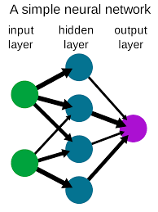
What is Neural Networks:
Neural networks are a type of computational model inspired by the structure and function of the human brain. They consist of interconnected nodes, called neurons, organized into layers. Neural networks are used in machine learning and deep learning to process and analyze data.
Basic Overview:
Input Layers
Output Layers
Hidden Layers

Slide 4
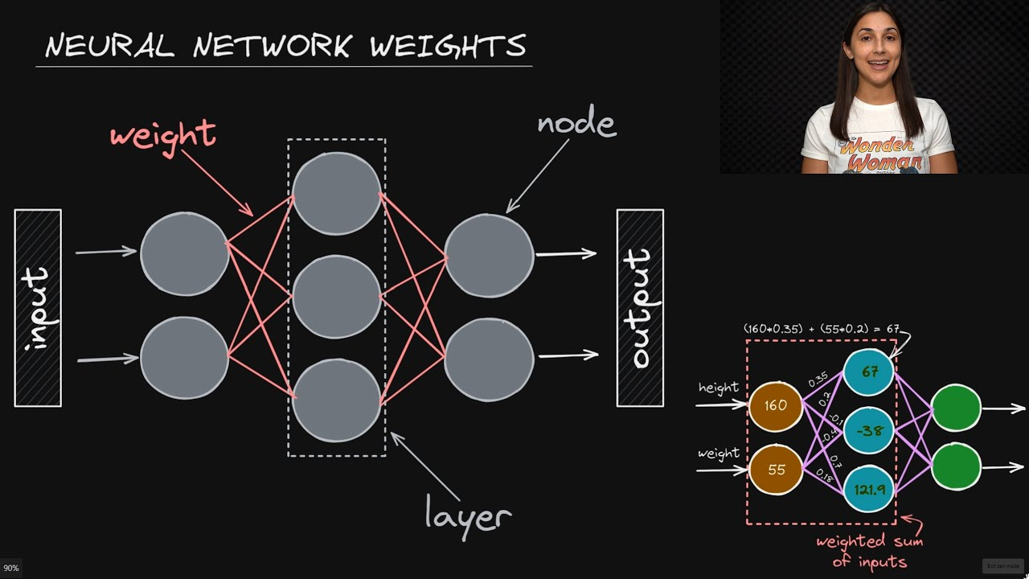
Weight:
In a neural network, a weight is a parameter associated with each connection between neurons. These weights determine the strength of the connection and are used to multiply the input data or activations when calculating the output of a neuron. During training, these weights are adjusted through optimization algorithms like gradient descent to make the network's predictions more accurate.

Slide 5
Gradient Descent:
Gradient descent is an optimization algorithm used in machine learning and deep learning to minimize the loss or error of a model by iteratively adjusting its parameters, such as weights and biases

Slide 6
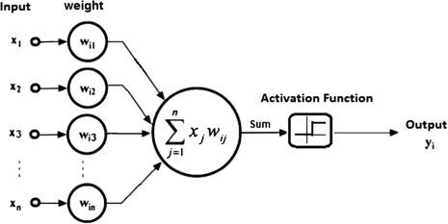
Activation Functions:
An activation function in neural networks is like a decision-making switch for artificial neurons, determining whether they should be "on" (active) or "off" (not active) based on the input they receive.This means that it will decide whether the neuron's input to the network is important or not in the process of prediction using simpler mathematical operations.

Slide 7
Activation Functions:
Sigmoid
Maps input values to a range between 0 and 1
Relu (Rectified Linear Unit)
Outputs the input if it's positive and 0 if it's negative.
Softmax
Used in the output layer for multi-class classification problems

Slide 8
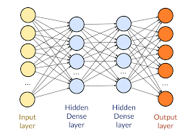
Keras:
Keras is a high-level api and this high-level api can run on multiple low-level api such as tensorflow etc. Keras works on the frontend and supports multiple backend engine.

Slide 9
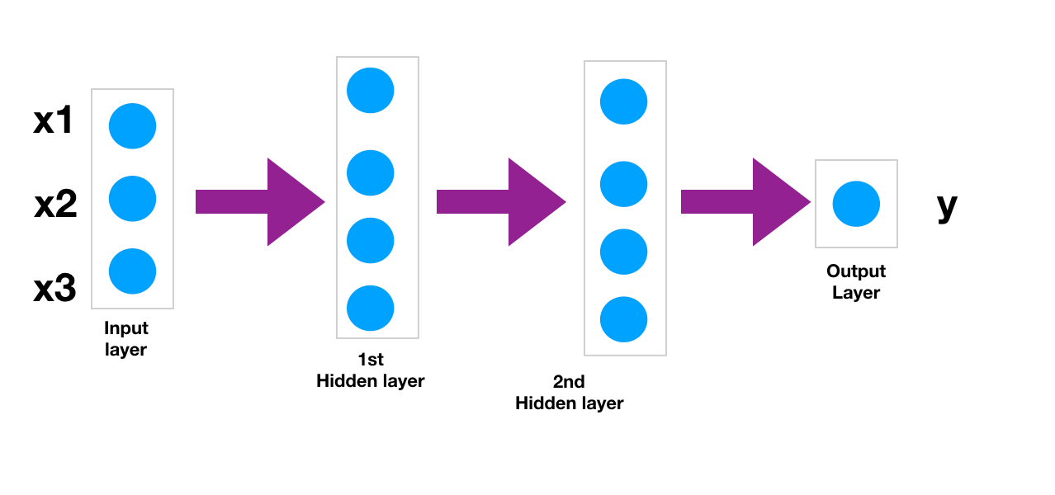
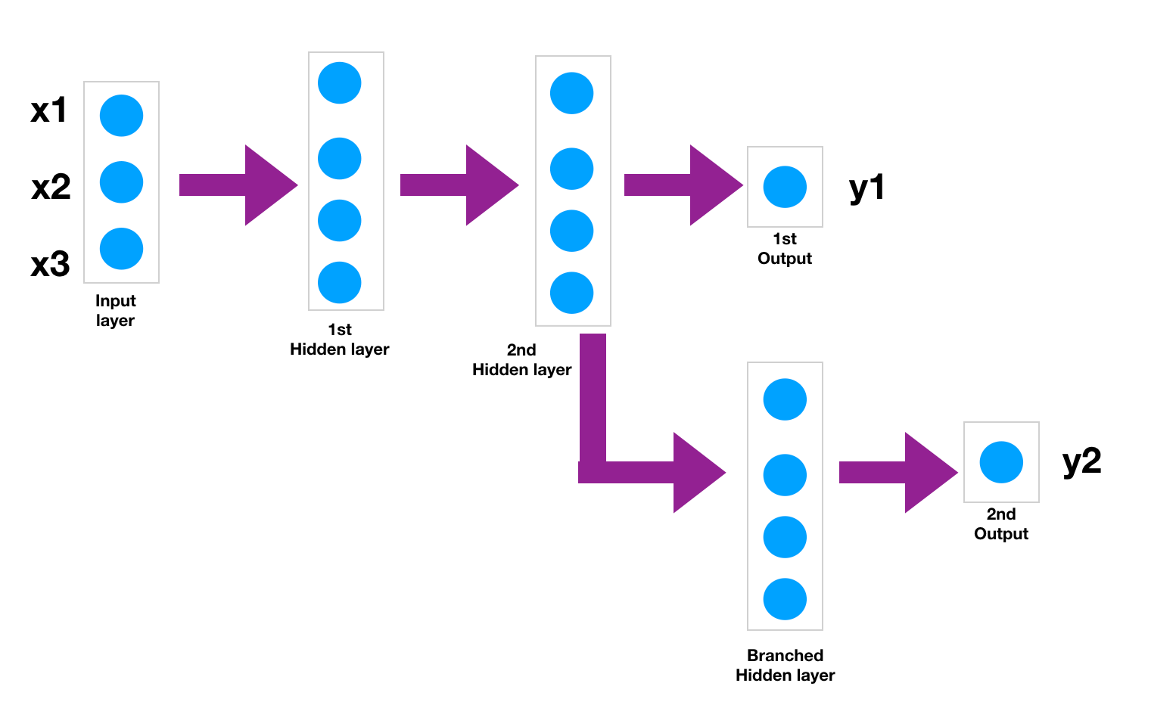
Models:
Sequential Model
Functional Mode

Slide 10
## Import the libraries
from tensorflow.keras.models import Sequential
from tensorflow.keras.layers import Dense, Activation
from tensorflow.keras.optimizers import Adam
## Creating the model
model = Sequential()
# Adding the first hidden layer with 4 neurons and ReLU activation function
model.add(Dense(4, activation='relu')) ##<----- You don't have to specify input size. Just define the hidden layers
# Adding the second hidden layer with 4 neurons and ReLU activation function
model.add(Dense(4, activation='relu'))
# Adding the output layer with 1 neuron (for regression) or more (for classification)
model.add(Dense(1))
## Defining the optimizer (Adam) and loss function (Mean Squared Error)
model.compile(optimizer='adam', loss='mse')
## Training the model
model.fit(x=X_train, y=y_train,
validation_data=(X_test, y_test),
batch_size=128, epochs=400)

Slide 11
## Import the libraries
from tensorflow.keras.models import Model
from tensorflow.keras.layers import Input, Dense
## Creating the layers
# Define the input layer with a shape of (3,)
input_layer = Input(shape=(3,))
# Adding the first hidden layer with 4 neurons and ReLU activation function
Layer_1 = Dense(4, activation="relu")(input_layer)
# Adding the second hidden layer with 4 neurons and ReLU activation function
Layer_2 = Dense(4, activation="relu")(Layer_1)
# Adding the output layer with 1 neuron (for regression) and linear activation function
output_layer = Dense(1, activation="linear")(Layer_2)
## Defining the model by specifying the input and output layers
model = Model(inputs=input_layer, outputs=output_layer)
## Defining the optimizer (Adam) and loss function (Mean Squared Error)
model.compile(optimizer='adam', loss='mse')
## Training the model
model.fit(X_train, y_train, epochs=400, batch_size=128, validation_data=(X_test, y_test))

Slide 12
Regularization:
Penalize the weight matrices of node. To avoid:
Underfitting
Overfitting
Techniques:
DropOut
Data Augmentation

Slide 13
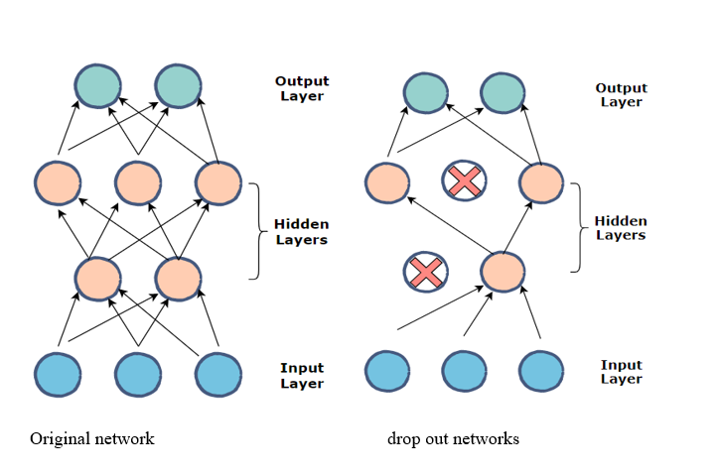
Dropout:
At every iteration, it randomly selects some nodes and remove them , along with all of their incoming and outgoing connections.

Slide 14
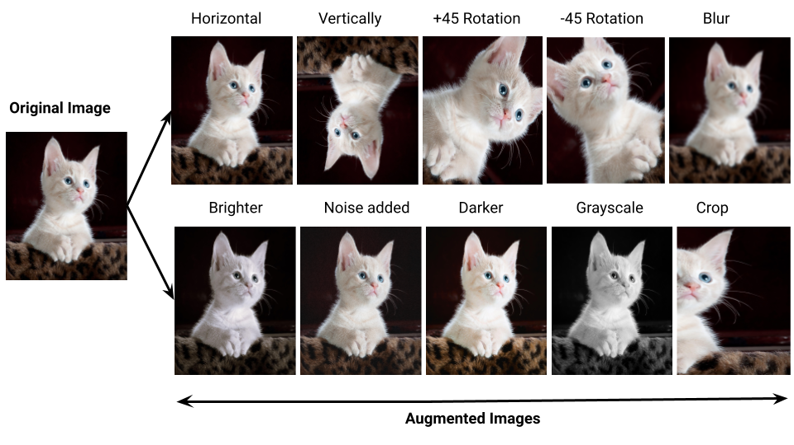
Data Augmentation:
Reduce Overfitting is to increase the size of training data.

Slide 15
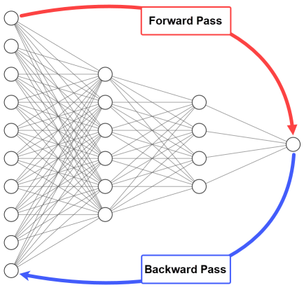
Forward and Backward Propagation:
Forward propagation computes network output; backward propagation calculates parameter gradients for optimization.

Slide 16
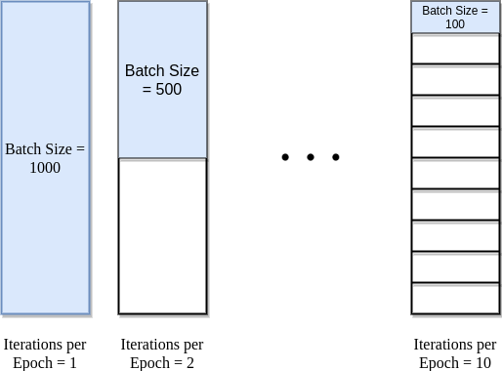
Epochs and Batch:
Epochs represent the number of complete passes through the training dataset.
Batch size determines the number of examples processed in each training iteration

